Slide 1
Data Normalization

Slide 2
Data Normalization
Primarily a tool to validate and improve a logical design so that it satisfies certain constraints that avoid unnecessary duplication of data
The process of decomposing relations with anomalies to produce smaller, well-structured relations

Slide 3
Well-Structured Relations
A relation that contains minimal data redundancy and allows users to insert, delete, and update rows without causing data inconsistencies
Goal is to avoid anomalies
Insertion Anomaly –adding new rows forces user to create duplicate data
Deletion Anomaly –deleting rows may cause a loss of data that would be needed for other future rows
Modification Anomaly –changing data in a row forces changes to other rows because of duplication
General rule of thumb: A table should not pertain to more than one entity type

Slide 4
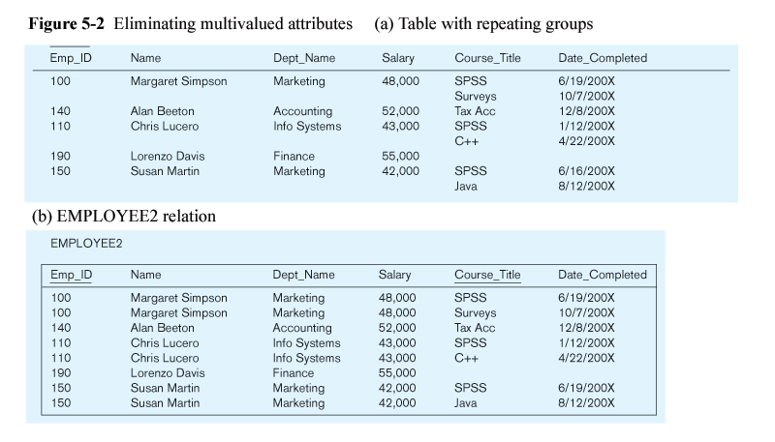
Example

Slide 5
Example –Figure 5-2b
Question–Is this a relation?
Answer–Yes: Unique rows and no multivalued attributes
Question–What’s the primary key?
Answer–Composite:
Emp_ID, Course_Title

Slide 6
Anomalies in this Table
Insertion–can’t enter a new employee without having the employee take a class
Deletion–if we remove employee 140, we lose information about the existence of a Tax Acc class
Modification–giving a salary increase to employee 100 forces us to update multiple records
Why do these anomalies exist?
Because there are two themes (entity types) in this one relation. This results in data duplication and an unnecessary dependency between the entities

Slide 7
Functional Dependencies and Keys
Functional Dependency: The value of one attribute (the determinant) determines the value of another attribute
Candidate Key:
A unique identifier. One of the candidate keys will become the primary key
E.g. perhaps there is both credit card number and SS# in a table…in this case both are candidate keys
Each non-key field is functionally dependent on every candidate key

Slide 8
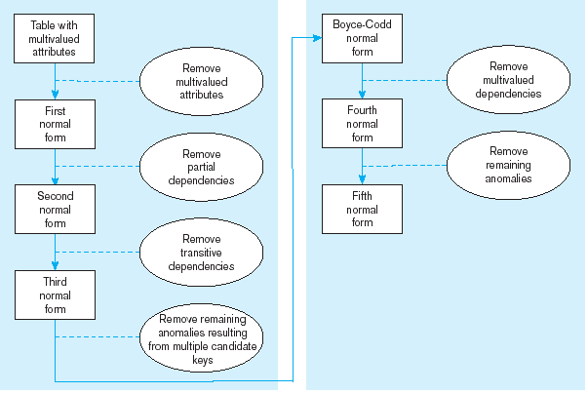
Figure 5.22 Steps in normalization

Slide 9
First Normal Form
No multivalued attributes
Every attribute value is atomic
Fig. 5-25 is not in 1st Normal Form (multivalued attributes) ➔ it is not a relation
Fig. 5-26 is in 1st Normal form
All relations are in 1st Normal Form

Slide 10
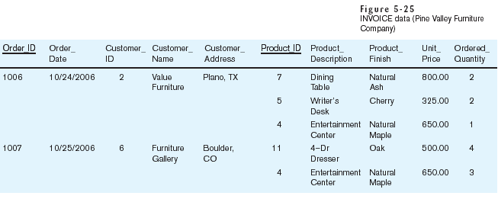
Table with multivalued attributes, not in 1st normal form
Note: this is NOT a relation

Slide 11
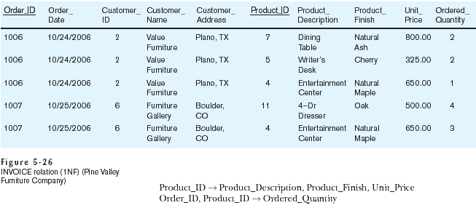
Table with no multivalued attributes and unique rows, in 1st normal form
Note: this is relation, but not a well-structured one

Slide 12
Anomalies in this Table
Insertion–if new product is ordered for order 1007 of existing customer, customer data must be re-entered, causing duplication
Deletion–if we delete the Dining Table from Order 1006, we lose information concerning this item's finish and price
Update–changing the price of product ID 4 requires update in several records
Why do these anomalies exist?
Because there are multiple themes (entity types) in one relation. This results in duplication and an unnecessary dependency between the entities

Slide 13
Second Normal Form
Must be in 1NF and
every non-key attribute is fully functionally dependent on the ENTIRE primary key
Every non-key attribute must be defined by the entire key, not by only part of the key
No partial functional dependencies

Slide 14
Figure 5-27 Functional dependency diagram for INVOICE
Order_ID ➔ Order_Date, Customer_ID, Customer_Name, Customer_Address
Customer_ID ➔ Customer_Name, Customer_Address
Product_ID ➔ Product_Description, Product_Finish, Unit_Price
Order_ID, Product_ID ➔ Order_Quantity
Therefore, NOT in 2nd Normal Form

Slide 15
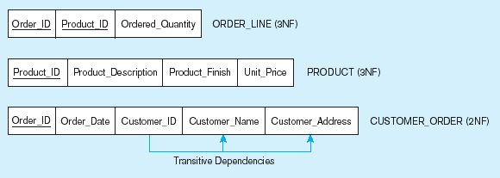
Figure 5-28 Removing partial dependencies
Getting it into Second Normal Form
Partial dependencies are removed, but there are still transitive dependencies

Slide 16
Third Normal Form
2NF PLUS no transitive dependencies (functional dependencies on non-primary-key attributes)
Note: This is called transitive, because the primary key is a determinant for another attribute, which in turn is a determinant for a third
Solution: Non-key determinant with transitive dependencies go into a new table; non-key determinant becomes primary key in the new table and stays as foreign key in the old table

Slide 17
Figure 5-28 Removing partial dependencies
Getting it into Third Normal Form
Transitive dependencies are removed

Slide 18
Merging Relations
View Integration – Combining entities from multiple ER models into common relations
Issues to watch out for when merging entities from different ER models:
Synonyms –two or more attributes with different names but same meaning
Homonyms –attributes with same name but different meanings
Transitive dependencies –even if relations are in 3NF prior to merging, they may not be after merging
Supertype/subtype relationships –may be hidden prior to merging

Slide 19
Enterprise Keys
Primary keys that are unique in the whole database, not just within a single relation
Corresponds with the concept of an object ID in object-oriented systems

Slide 20
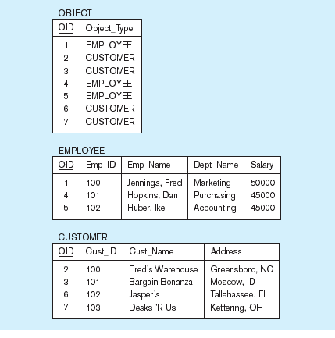
Figure 5-31 Enterprise keys
a) Relations with enterprise key
b) Sample data with enterprise key

Slide 21
التطبيع (Normalization)
التطبيع هو تحويل هياكل البيانات المركبة إلى هياكل بيانات بسيطة ومُستقرة.

Slide 22
خطوات التطبيع Steps in Normalization

Slide 23
التبعيات الوظيفية والمفاتيح Functional Dependence & Keys
التبعية الوظيفية هي علاقة معينة بين خاصتين. في العلاقة “R”، تعتبر الخاصية “B” تابعة وظيفيًا للخاصية “A” إذا كانت كل قيمة “A” تحدد قيمة واحدة “B”. وتُمَثل هكذا A → B.
EMPCRS (EMP#, CRS#, DATE_COMPLETED)
EMP#, CRS# → DATE_COMPLETED
المحدد (Determinant) هو خصائص الجانب الأيسر للتبعية الوظيفية.

Slide 24
قواعد التبعيات الوظيفية Rules of Functional Dependency
If X, Y, Z, and W are attributes in a relation, then:
1. X → X (reflexivity)الارتداد
2. If X → Y then XZ → Y (augmentation)الازدياد
3. If X → Y and X → Z then X → YZ (union)الاتحاد
4. If X → Y then X → Z where Z is a subset of Y (decomposition)التفكيك
5. If X → Y and Y → Z then X → Z (transitivity)الانتقالية
6. If X → Y and YZ → W then XZ → W (pseudotransitivity)الانتقالية الزائفة

Slide 25
أمثلة لقواعد التبعيات الوظيفية
1.الازدياد
STD# → STD_NAME then STD#, CRS# → STD_NAME
2.الانتقالية
STD# → MAJOR and MAJOR → ADVISOR
then STD# → ADVISOR
3.الانتقالية الزائفة
STD# → MAJOR and MAJOR, CLASS → ADVISOR
then STD#, CLASS → ADVISOR

Slide 26
الأشكال الطبيعية الأساسية The Basic Normal Forms

Slide 27
عينة بيانات تقرير الدرجات
GRADE_REPORT
GRADE | INSTRUCTOR LOCATION | INSTRUCTOR NAME | COURSE TITLE | COURSE# | MAJOR | STUDENT NAME | STUDENT#
A B | 1024 1030 | Saleh Ahmad | Database Mgt System Analysis | IS 350 IS 465 | IS | Saad | 2773777
C A B | 1030 1025 1030 | Ahmad Soud Ahmad | System Analysis Production Mgt Operations Res | IS 465 PM 300 QM 440 | PM | Ali | 6917773
 |  |  |  |  |  |  | …

Slide 28
الشكل الطبيعي الأول (1NF)
GRADE_REPORT
GRADE | INSTRUCTOR LOCATION | INSTRUCTOR NAME | COURSE TITLE | COURSE# | MAJOR | STUDENT NAME | STUDENT#
A B | 1024 1030 | Saleh Ahmad | Database Mgt System Analysis | IS 350 IS 465 | IS IS | Saad Saad | 2773777 2773777
C A B | 1030 1025 1030 | Ahmad Soud Ahmad | System Analysis Production Mgt Operations Res | IS 465 PM 300 QM 440 | PM PM PM | Ali Ali Ali | 6917773 6917773 6917773
 |  |  |  |  |  |  | …

Slide 29
الشكل الطبيعي الثاني (2NF)

Slide 30
الشكل الطبيعي الثاني (2NF)
تحليل التبعيات الوظيفية
1. STUDENT(STUDENT#, STUDENT_NAME,MAJOR)
2. COURSE_INSTRUCTOR(COURSE#, COURSE_TITLE, INSTRUCTOR_NAME, INSTRUCTOR_LOCATION)
3. REGISTRATION(STUDENT#, COURSE#, GRADE)
العلاقة في الشكل الطبيعي الثاني إذا كانت في الشكل الطبيعي الأول ولا تحتوي على تبعيات جزئية.

Slide 31
STUDENT
MAJOR | STUDENT NAME | STUDENT#
IS | Saad | 2773777
PM | Ali | 6917773
 |  | ...
COURSE_INSTRUCTOR
INSTRUCTOR LOCATION | INSTRUCTOR NAME | COURSE TITLE | COURSE#
1024 | Saleh | Database Mgt | IS 350
1030 | Ahmad | System Analysis | IS 465
1025 | Soud | Production Mgt | PM 300
1030 | Ahmad | Operations Res | QM 440
RGISTRATION
GRADE | COURSE# | STUDENT#
A | IS 350 | 2773777
B | IS 465 | 2773777
C | IS 465 | 6917773
A | PM 300 | 6917773
B | QM 440 | 6917773
 |  | ...

Slide 32
الشكل الطبيعي الثالث (3NF)
التبعيات الوظيفية في ”COURSE_INSTRUCTOR”
1. COURSE# → COURSE_TITLE, INSTRUCTOR_NAME, INSTRUCTOR_LOCATION
2. INSTRUCTOR_NAME → INSTRUCTOR_LOCATION
COURSE
INSTRUCTOR
INSTRUCTOR LOCATION | INSTRUCTOR NAME |  | INSTRUCTOR NAME | COURSE TITLE | COURSE#
1024 | Saleh |  | Saleh | Database Mgt | IS 350
1030 | Ahmad |  | Ahmad | System Analysis | IS 465
1025 | Soud |  | Soud | Production Mgt | PM 300
 | ... |  | Ahmad | Operations Res | QM 440

Slide 33
الشكل الطبيعي الثالث (3NF)
العلاقة في الشكل الطبيعي الثالث إذا كانت في الشكل الطبيعي الثاني ولا تحتوي علي تبعيات انتقالية.
STUDENT(STUDENT#, STUDENT_NAME,MAJOR)
COURSE_INSTRUCTOR(COURSE#, COURSE_TITLE, INSTRUCTOR_NAME)
INSTRUCTOR(INSTRUCTOR_NAME, INSTRUCTOR_LOCATION)
REGISTRATION(STUDENT#, COURSE#, GRADE)

Slide 34
أشكال طبيعية إضافية (Additional Normal Forms)
الشكل الطبيعي بويس- كود BCNF”) “ (Boyce-Codd Normal Form
STUDENT_MAJOR_ADVISOR
ADVISOR | MAJOR | STUDENT#
EINSTEIN | PHYSICS | 123
MOZART | MUSIC | 123
DARWIN | BIOL | 456
BOHR | PHYSICS | 789
EINSTEIN | PHYSICS | 999
STUDENT#, MAJOR → ADVISOR
ADVISOR → MAJOR

Slide 35
تابع الشكل الطبيعي بويس-كود
العلاقة في الشكل الطبيعي بويس- كود “BCNF” إذا كان كل محدد فيها مفتاح مرشح.
ST_ADV
ADV_MAJ
MAJOR | ADVISOR |  | ADVISOR | STUDENT
PHYSICS | EINSTEIN |  | EINSTEIN | 123
MUSIC | MOZART |  | MOZART | 123
BIOL | DARWIN |  | DARWIN | 456
PHYSICS | BOHR |  | BOHR | 789
 |  |  | EINSTEIN | 999

Slide 36
الشكل الطبيعي الرابع 4NF”) “(4th Normal Form
OFFERING
TEXTBOOK | INSTRUCTOR | COURSE
Drucker | Ali | Management
Drucker | Ahmad | Management
Drucker | Saad | Management
Peters | Ali | Management
Peters | Ahmad | Management
Peters | Saad | Management
Weston | Gamil | Finance
Gulford | Gamil | Finance
COURSE ➔➔ INSTRUCTOR
COURSE ➔➔ TEXTBOOK

Slide 37
الشكل الطبيعي الرابع 4NF”) “(4th Normal Form
العلاقة في الشكل الطبيعي الرابع اذا كانت في الشكل الطبيعي بويس-كود “BCNF” ولا تحتوي على تبعيات متعددة القيم.
TEACHER
TEXT
TEXTBOOK | COURSE |  | INSTRUCTOR | COURSE
Drucker | Management |  | Ali | Management
Peters | Management |  | Ahmad | Management
Weston | Finance |  | Saad | Management
Gulford | Finance |  | Gamil | Finance

Slide 38
دمج العلاقات (Merging Relations)
EMPLOYEE1(EMP#, NAME, ADDRESS, PHONE)
EMPLOYEE2(EMP#, NAME, ADDRESS, JOBCODE, #YEARS)
تمثلان نفس الكينونة ويمكن دمجهما لتُكَوِّنا العلاقة:
EMPLOYEE(EMP#, NAME, ADDRESS, PHONE, JOBCODE, #YEARS

Slide 39
مشكلات دمج العلاقات
المترادفات (Synonyms):
يجب إعطاء أسماء قياسية للخصائص المترادفة عند الدمج وحذف المترادفات الأخرى.
تماثل الأسماء واختلاف المعنى Homonyms) )
STUDENT1(STD#, NAME, ADDRESS)
STUDENT2(STD#, NAME, PHON#, ADDRESS)
عنوان الطالب في العلاقة الأولي هو عنوانه في الجامعة فى حين أن عنوانه في العلاقة الثانية هو عنوانه المنزلي.
STUDENT(STD#, NAME, PHON#, CAMPUS_ADD, HOME_ADD)

Slide 40
مشكلات دمج العلاقات
التبعيات الانتقالية (Transitive Dependencies)
STUDENT1(STUDENT_ID, MAJOR)
STUDENT2(STUDENT_ID, ADVISOR)
بدمج هاتين العلاقتين تنتج العلاقة:
STUDENT(STUDENT_ID, MAJOR, ADVISOR)
بفرض الحالة MAJOR → ADVISOR، تصبح العلاقة STUDEN
في الشكل الطبيعي الثاني ويتم تحويلها للشكل الطبيعي الثالث كالتالي:
STUDENT(STUDENT_ID, MAJOR)
MAJ_ADV (MAJOR, ADVISOR)

